Slide 1
Electronic Resources
5th Grade Research Project

Slide 2
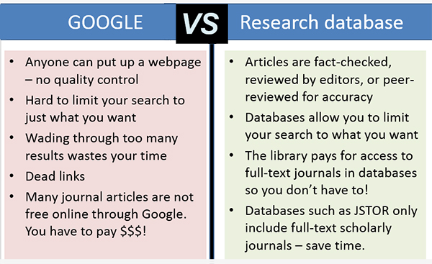
What is a database?
An electronic collection of magazines, scholarly journals, and newspapers
Peer-reviewed contain reliable information

Slide 3
How do I get to our school’s databases?
The Hub
Student Links and Resources
Destiny Library
Drexler Middle School

Slide 4
Database username and password
Username: kaea106
Password: kaea01

Slide 5
What database will be helpful to me?
Britannica School

Slide 6
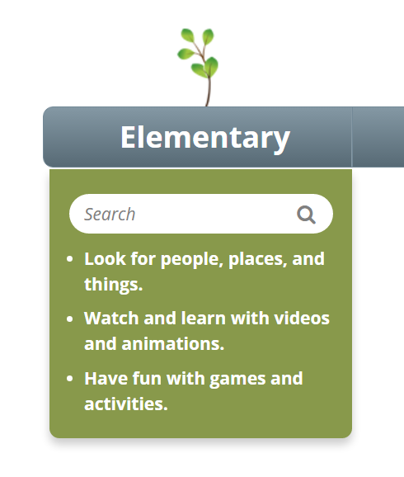
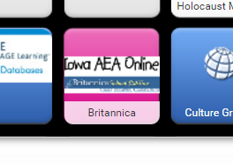
How do I use Britannica?
Select the pink Britannica icon
Select elementary
Type your keyword into the white search box
1.
2.

Slide 7
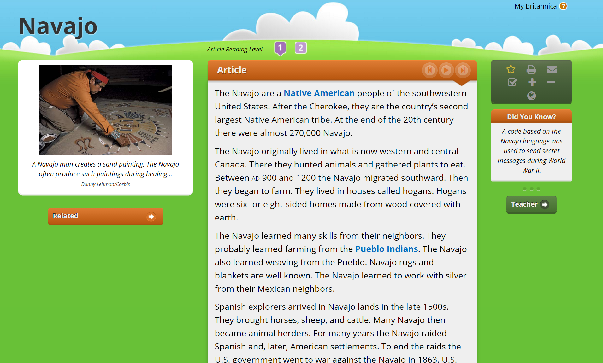
What can Britannica do for me?
Adjust reading level
Read the article to me
Increase font size
Cite article
Print and/or email
to myself

Slide 8
Super basic Boolean… (What’s a Boolean?)
A Boolean search is using the words AND, OR, and NOT to make your search easier and more effective!
First, figure out your keywords
Single words or short phrases work best
Example:
Research Question: What influence did Sacagawea have on the Lewis and Clark Expedition?
Keywords: Sacagawea, “Lewis and Clark Expedition,” and role
Put quotation marks around your key phrases, otherwise the database will search for those words in any order

Slide 9
Searching using Boolean…
Use the word AND to link terms together NARROW
Example: Sacagawea AND “Lewis and Clark”
Use the word OR to include synonyms
Example: Native Americans OR American Indian OR Indians OR Native Peoples EXPAND
Use the word NOT to exclude a word in your results
Example: Sioux NOT county NOT city NARROW

Slide 10
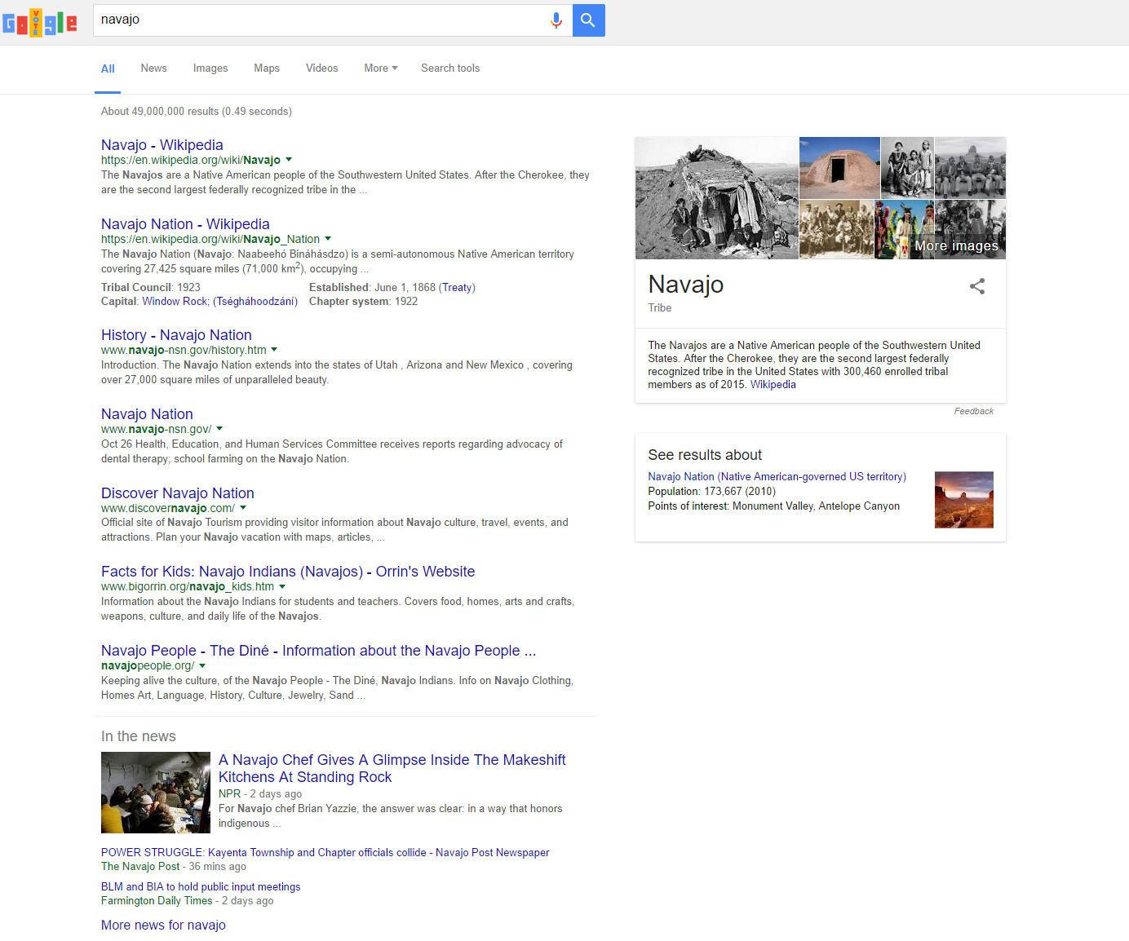
How do I find a reliable website?
Avoid .com
.edu, .org, and .gov are best,
however… ALWAYS consider
what agendas website
publishers/authors may have

Slide 11
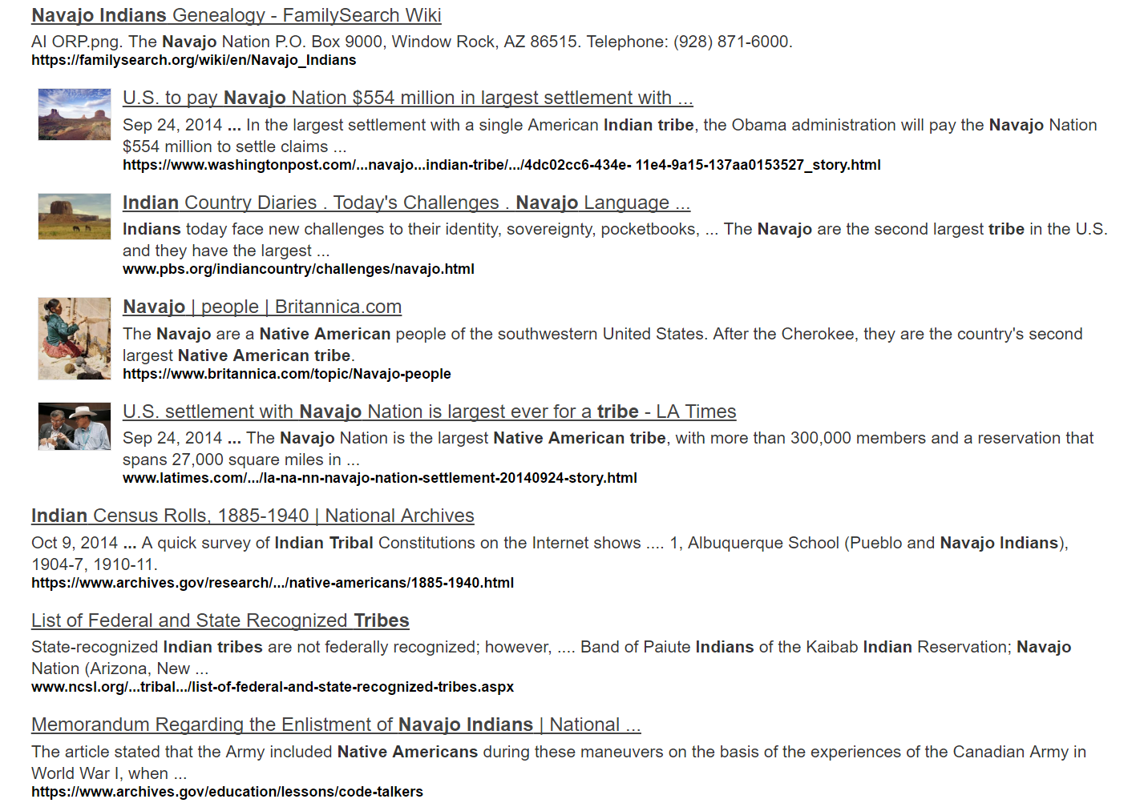
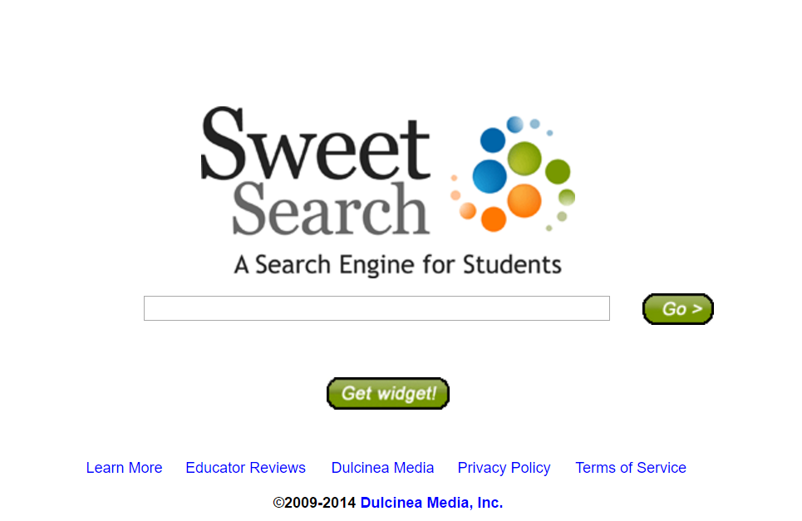
WHAT!? A search engine other then Google?
Sweet Search
An academic version of Google

Slide 12
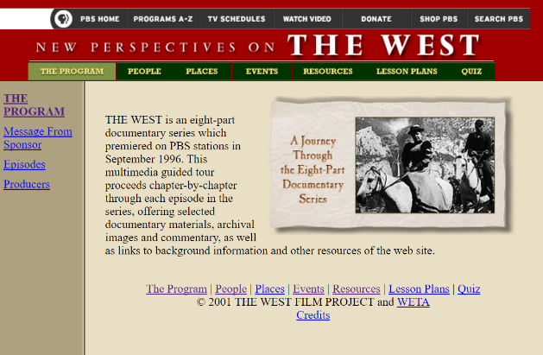
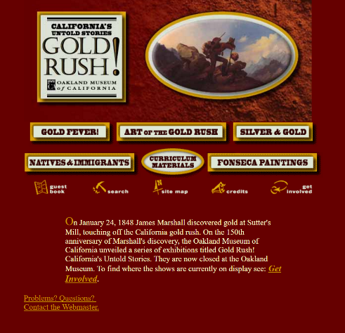
Other helpful websites!
PBS: New Perspectives on the West
Search for primary sources on your topic
http://www.pbs.org/weta/thewest/resources/archives/index.htm
PBS: Lewis & Clark, The Journey of the Corps of Discovery
Detailed information on the Lewis & Clark expedition
http://www.pbs.org/lewisandclark/
Oakland Museum of California: Gold Rush!
Lets you explore the Oakland Museum’s gold rush exhibit
http://explore.museumca.org/goldrush/fever.html
The Oregon Trail
Includes information on the trail, real people who traveled the trail, and diaries and journals from actual travelers
http://oregontrail101.com/allabout.html
National Museum of the Native American
Allows you to explore multiple museum exhibits on Native Americans
http://www.nmai.si.edu/

